Slide 1
DNA sequencing

Slide 2
Sequencing Methods
Maxam/Gilbert chemical sequencing
Sanger chain termination sequencing
Pyrosequencing

Slide 3
Maxam Gilbert Sequencing
purines (A+G) are depurinated using formic acid,
the guanines are methylated by dimethyl sulfate
the pyrimidines (C+T) are hydrolysed using hydrazine.
The addition of salt (sodium chloride) to the hydrazine reaction inhibits the reaction of Thymine
. The modified DNAs may then be cleaved by hot piperidine at the position of the modified base

Slide 4
Maxam-Gilbert Sequencing
3′
A
A
G
C
A
A
C
G
T
G
C
A
G
5′
G G+A T+C C
Longer fragments
Shortest fragments
A
G
Sequencing gels are read from bottom to top (5′ to 3′).

Slide 5
Maxam-Gilbert Sequencing
The double stranded DNA is labelled at the 5” end and then using DMSO and heat denatured into single stranded. The single strands are separated by gel electrophoresis (Different GC content)
DMS
FA
H
H+S
G
G
C
C
G
A
T
C
G
G
T
C
G
G
C
A
T
C
G
C
A
C
A
T
Maxam-Gilbert sequencing is performed by chain breakage at specific nucleotides.

Slide 6
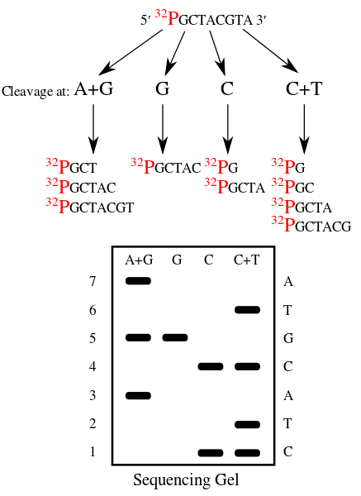

Slide 7
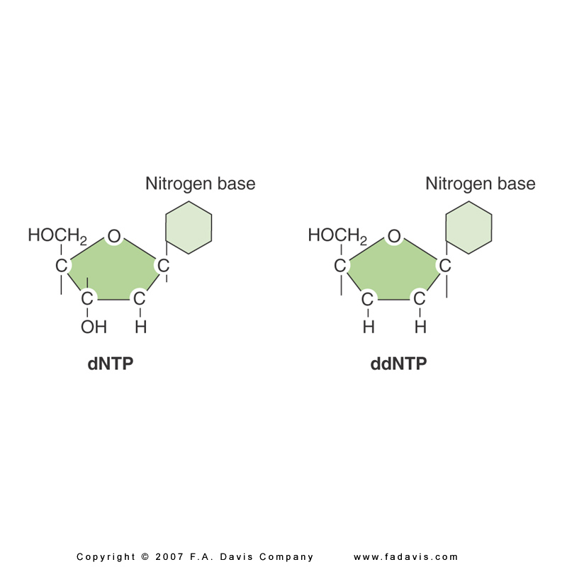
Chain Termination (Sanger) Sequencing
A modified DNA replication reaction.
Growing chains are terminated by dideoxynucleotides.

Slide 8
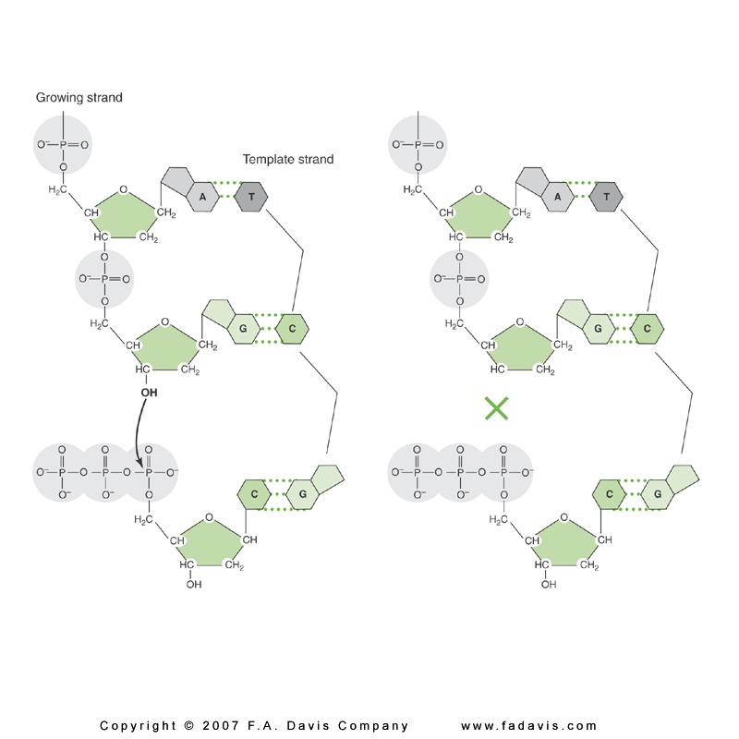
Chain Termination (Sanger) Sequencing
The 3′-OH group necessary for formation of the phosphodiester bond is missing in ddNTPs.
Chain terminates
at ddG

Slide 9
Chain Termination (Sanger) Sequencing
A sequencing reaction mix includes labeled primer and template.
Dideoxynucleotides are added separately to each of the four tubes.
Primer
5′OP-
-3′ OH
TCGACGGGC…
Template
Template area to be sequenced

Slide 10
Chain Termination (Sanger) Sequencing
ddATP +
ddA
A
C
G
T
four
dNTPs
dAdGdCdTdGdCdCdCdG
ddCTP +
dAdGddC
four
dNTPs
dAdGdCdTdGddC
dAdGdCdTdGdCddC
dAdGdCdTdGdCdCddC
ddGTP +
dAddG
four
dNTPs
dAdGdCdTddG
dAdGdCdTdGdCdCdCddG
ddTTP +
dAdGdCddT
four
dNTPs
dAdGdCdTdGdCdCdCdG

Slide 11
Chain Termination (Sanger) Sequencing
With addition of enzyme (DNA polymerase), the primer is extended until a ddNTP is encountered.
The chain will end with the incorporation of the ddNTP.
With the proper dNTP:ddNTP ratio, the chain will terminate throughout the length of the template.
All terminated chains will end in the ddNTP added to that reaction.

Slide 12
Chain Termination (Sanger) Sequencing
The collection of fragments is a sequencing ladder.
The resulting terminated chains are resolved by electrophoresis.
Fragments from each of the four tubes are placed in four separate gel lanes.

Slide 13
Chain Termination (Sanger) Sequencing
3′
G
G
T
A
A
A
T
C
A
T
G
5′
G A T C
Longer fragments
Shorter fragments
ddG
ddG
Sequencing gels are read from bottom to top (5′ to 3′).

Slide 14
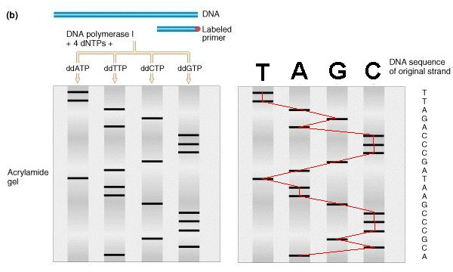
Sequencing Gel

Slide 15
Fluorescent Dyes
Fluorescent dyes are multicyclic molecules that absorb and emit fluorescent light at specific wavelengths.
Examples are fluorescein and rhodamine derivatives.
For sequencing applications, these molecules can be covalently attached to nucleotides.

Slide 16
Fluorescent Dyes
In dye primer sequencing, the primer contains fluorescent dye–conjugated nucleotides, labeling the sequencing ladder at the 5′ ends of the chains.
In dye terminator sequencing, the fluorescent dye molecules are covalently attached to the dideoxynucleotides, labeling the sequencing ladder at the 3′ ends of the chains.
ddA
ddA

Slide 17
Dye Terminator Sequencing
A distinct dye or “color” is used for each of the four ddNTP.
Since the terminating nucleotides can be distinguished by color, all four reactions can be performed in a single tube.
A
T
The fragments are distinguished by size and “color.”
AC
GT
G
T

Slide 18
Dye Terminator Sequencing
The DNA ladder is resolved in one gel lane or in a capillary.
GA
TC
G A T C
G
T
C
T
G
A
Slab gel
Capillary

Slide 19
Dye Terminator Sequencing
The DNA ladder is read on an electropherogram.
Slab gel
Capillary
Electropherogram
5′ AGTCTG

Slide 20
Automated Sequencing
Dye primer or dye terminator sequencing on capillary instruments.
Sequence analysis software provides analyzed sequence in text and electropherogram form.
Peak patterns reflect mutations or sequence changes.
T/T T/A A/A
5′ AGTCTG
5′ AG(T/A)CTG
5′ AGACTG

Slide 21
Alternative Sequencing Methods:
Pyrosequencing
Pyrosequencing is based on the generation of light signal through release of pyrophosphate (PPi) on nucleotide addition.
  DNA_{n} + dNTP → DNA_{n+1} + PP_{I}
PPi is used to generate ATP from adenosine phosphosulfate (APS).
  APS + PP_{I} → ATP
ATP and luciferase generate light by conversion of luciferin to oxyluciferin.

Slide 22
Alternative Sequencing Methods:
Pyrosequencing
Each nucleotide is added in turn.
Only one of four will generate a light signal.
The remaining nucleotides are removed enzymatically.
The light signal is recorded on a pyrogram.
DNA sequence: A T C A GG CC T
Nucleotide added : A T C A G C T

Slide 23
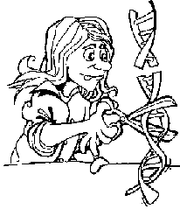
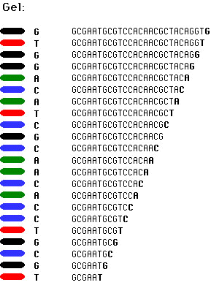
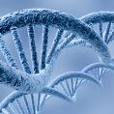

Genome Sequencing
AC..GC
TG..GT
TC..CC
TT..TC
CG..CA
AC..GC
GA..GC
TG..AC
CT..TG
GT..GC
AC..GC
AC..GC
AA..GC
AT..AT
TT..CC
Genome
Short fragments of DNA
Short DNA sequences
ACGTGGTAA CGTATACAC TAGGCCATA
GTAATGGCG CACCCTTAG
TGGCGTATA CATA…
ACGTGGTAATGGCGTATACACCCTTAGGCCATA
ACGTGACCGGTACTGGTAACGTACA
CCTACGTGACCGGTACTGGTAACGT
ACGCCTACGTGACCGGTACTGGTAA
CGTATACACGTGACCGGTACTGGTA
ACGTACACCTACGTGACCGGTACTG
GTAACGTACGCCTACGTGACCGGTA
CTGGTAACGTATACCTCT...
Sequenced genome

